Slide 1

Modern .NET Software Architecture
Where are we today?
Christoph Pletz, CL-SOL
Manuel Meyer, ZH-AD

Slide 2
Agenda
TicTacMicroservice
A Brief History of Software Engineering
Microservice Characteristics
Microservice Examples
Inside TicTacMicroservice
Summary

Slide 3
TODO:
Tasks:
MME:
QR-Code in Präsentation einbauen.
CPL:
Demos fertig machen
Slides ergänzen
Nach Azure Deployen
Ablauf Begrüssung (1min, MME)
Free4All TicTacTech via QR Code (10min, CPL)
Slides bis TicTacTech (10min, MME)
Erklärung TicTacTech (10min, CPL)
Ausblick (2 min, MME)
Zusammenfassung (3 min, CPL)

Slide 4
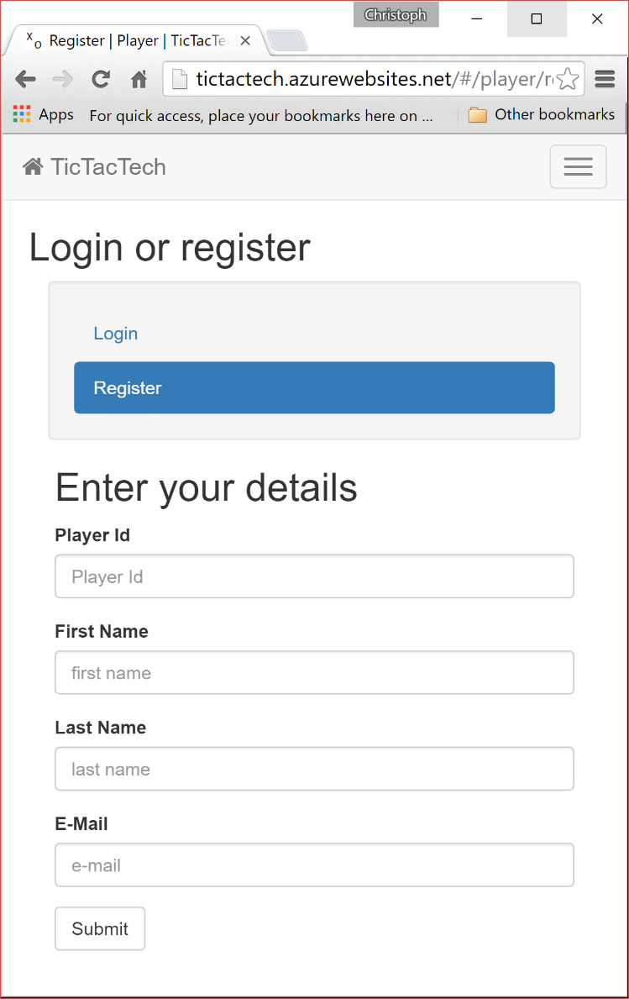
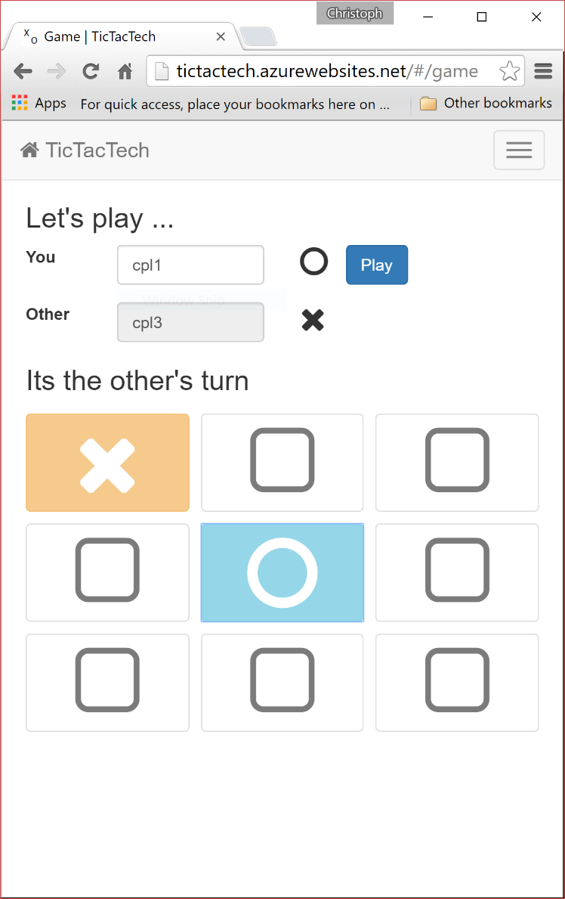
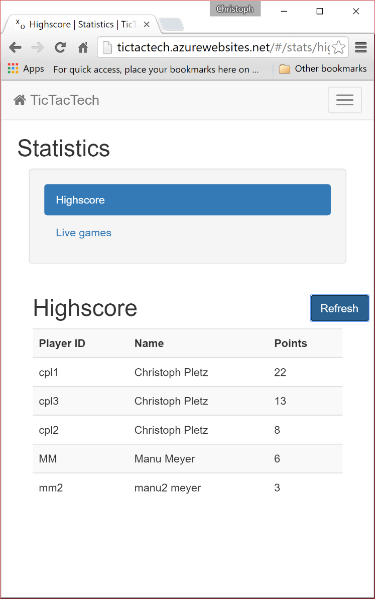
TicTacTech
Player
Game
Statistics

Slide 5

TicTacTech
On Android I had problems with Chrome, but it works great with Opera !?
http://tictactech.azurewebsites.net/

Slide 6
A Brief History of
Sofware Engineering

Slide 7
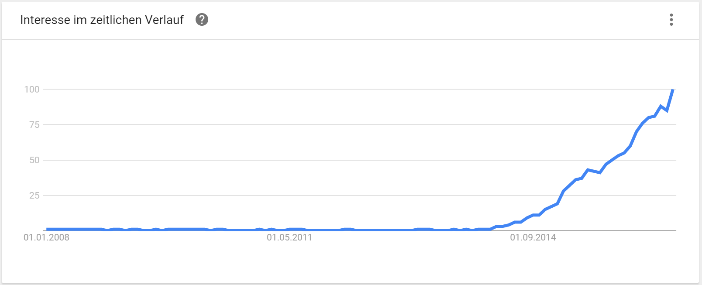
A Look Around Today
Google Trend „Microservices“

Slide 8
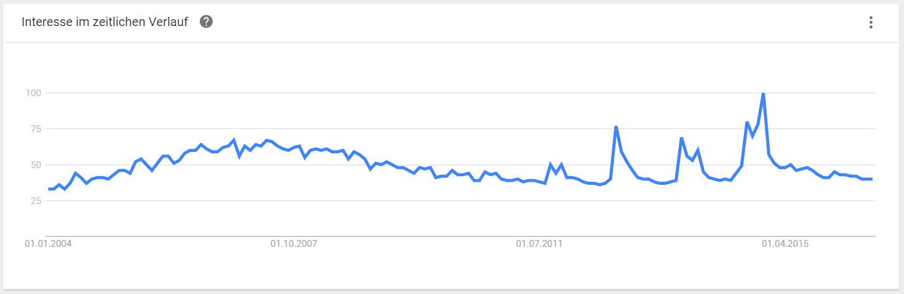
A Look Around Today
Google Trend „SOA“

Slide 9

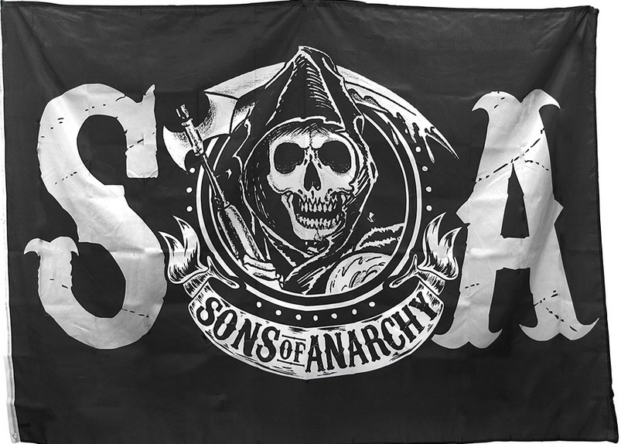
A Look Around Today
Google Trend „SOA“

Slide 10
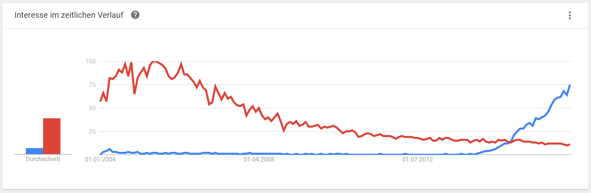
A Look Around Today
Google Trend „Microservices“ versus „Service Oriented Architecture“

Slide 11
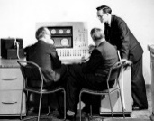
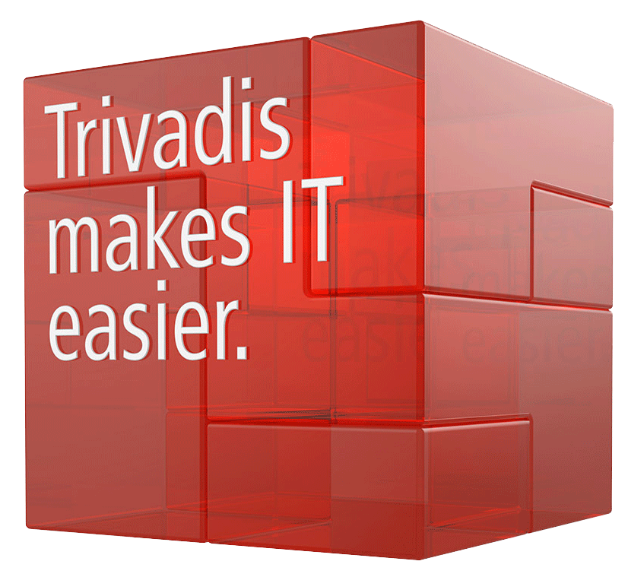
A Brief History of Software Engineering
Mark 1
09.09.2016
1940
Notes:
Mark 1 5 Tonnen sowie eine Frontlänge von 16 Metern.

Slide 12
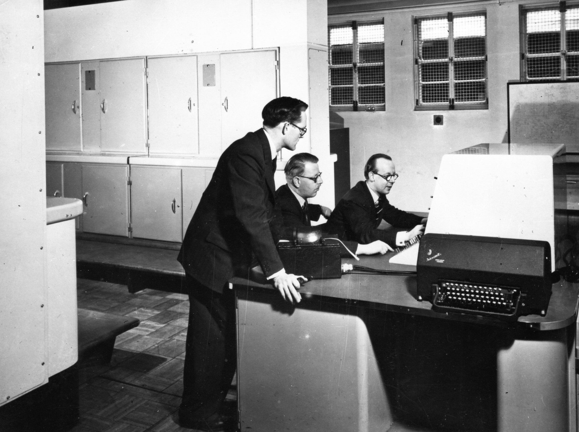
The Unix Philosophy (1978) - DOTADIW

Slide 13
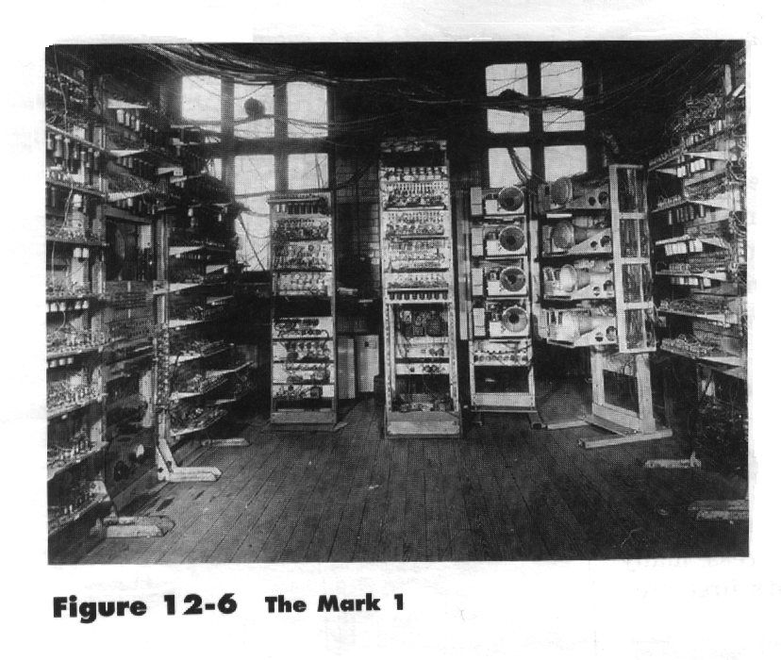

Slide 14
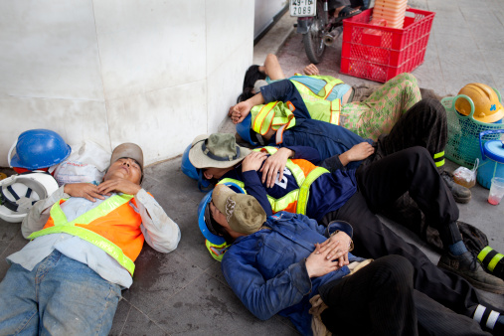

Slide 15
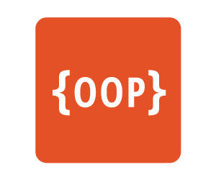
A Brief History of Software Engineering
The UNIX
Philosophy
(DOTADIW)
Mark 1
09.09.2016
1978
1940
1970
Notes:
Mark 1 5 Tonnen sowie eine Frontlänge von 16 Metern.

Slide 16
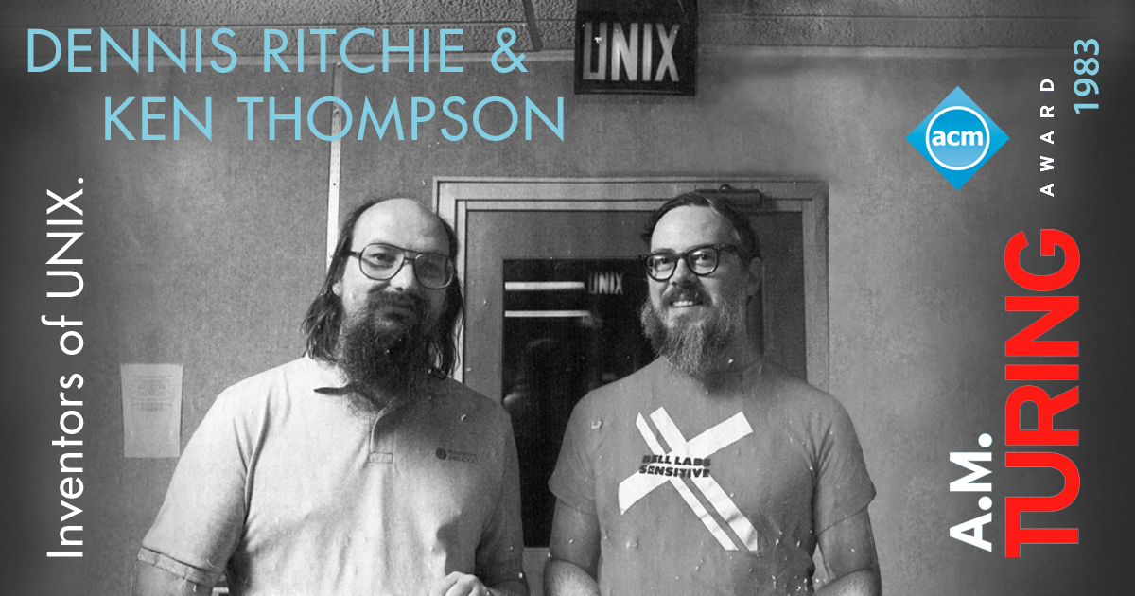
The Unix Philosophy (1978) - DOTADIW
Notes:
Ritchie: Unix, C
Thompson: B, UTF-8, Go

Slide 17
The Unix Philosophy (1978) - DOTADIW
„Do one thing and do it well“
Make each program do one thing well
Expect the output of every program to become the input to another
Design software and systems to be tried early, don‘t hesitate to throw away
Use and make tools.

Slide 18
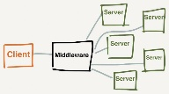
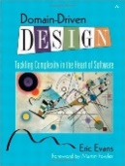


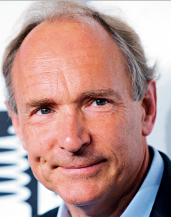

A Brief History of Software Engineering
SOA
The UNIX
Philosophy
(DOTADIW)
DDD
Agile Manifesto
Reactive Manifesto
DevOps
09.09.2016
Mark 1
1978
1996
2001
2003
2007
2013
1940
1970
1989
2000
2002
2005
2011
RESTful
Services
‘’Micro-Web-Services‘’
Microservices
WWW
The Cloud
Notes:
Mark 1 5 Tonnen sowie eine Frontlänge von 16 Metern.

Slide 19
The Reactive Manifesto
REACTIVE
Elastic
Responsive
Resilient
Message Driven
https://www.reactivemanifesto.org/

Slide 20
A Brief History of Software Engineering
SOA
The UNIX
Philosophy
(DOTADIW)
DDD
Agile Manifesto
Reactive Manifesto
DevOps
09.09.2016
Mark 1
1978
1996
2001
2003
2007
2013
1940
1970
1989
2000
2002
2005
2011
RESTful
Services
‘’Micro-Web-Services‘’
Microservices
WWW
The Cloud
Notes:
Mark 1 5 Tonnen sowie eine Frontlänge von 16 Metern.

Slide 21
Microservice Characteristics

Slide 22

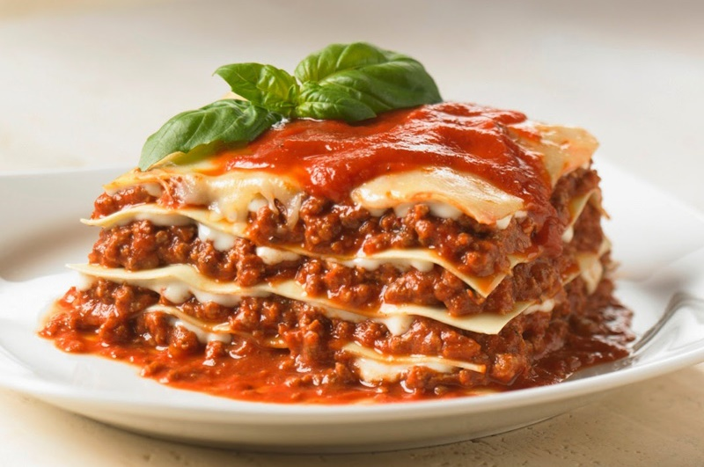
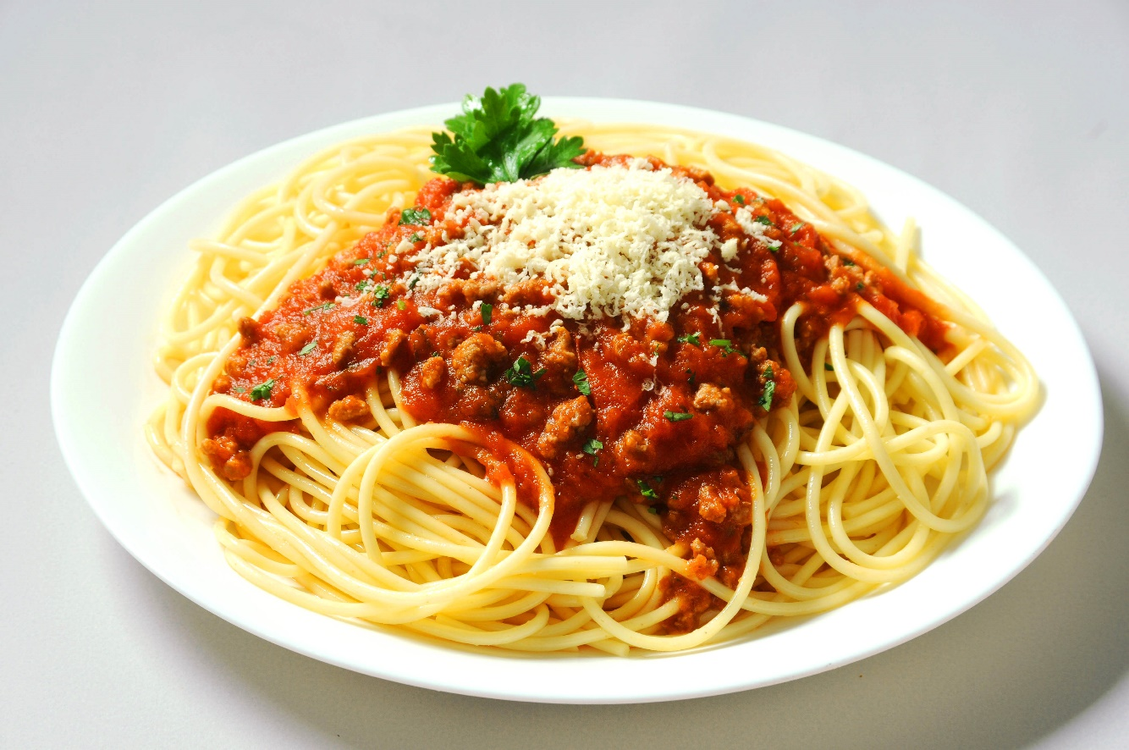
The Evolution of Software Architecture

Slide 23
Microservice Characteristics
Small and self contained, owns its datasource, owned by 1 team
Easy to replace, individually deployable and disposable
Organized around capabilities
Implemented with „what fits best“
„Smart endpoints and dumb pipes“
Designed for failure
http://martinfowler.com/articles/microservices.html/
Notes:
Rest protocols instead of WS* or BPEL or ESB.

Slide 24
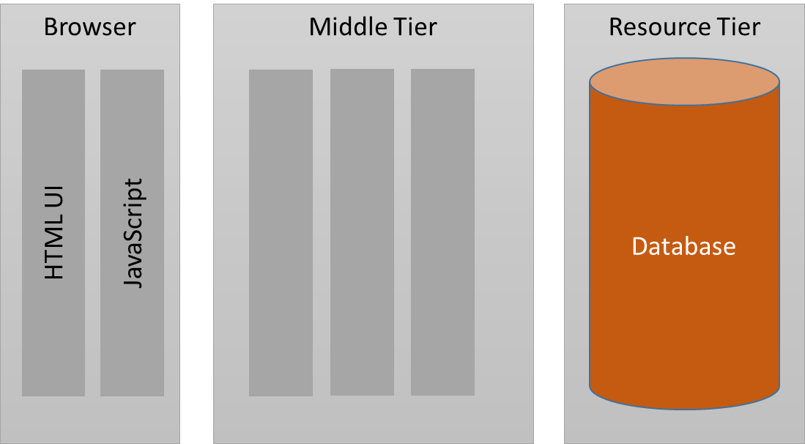
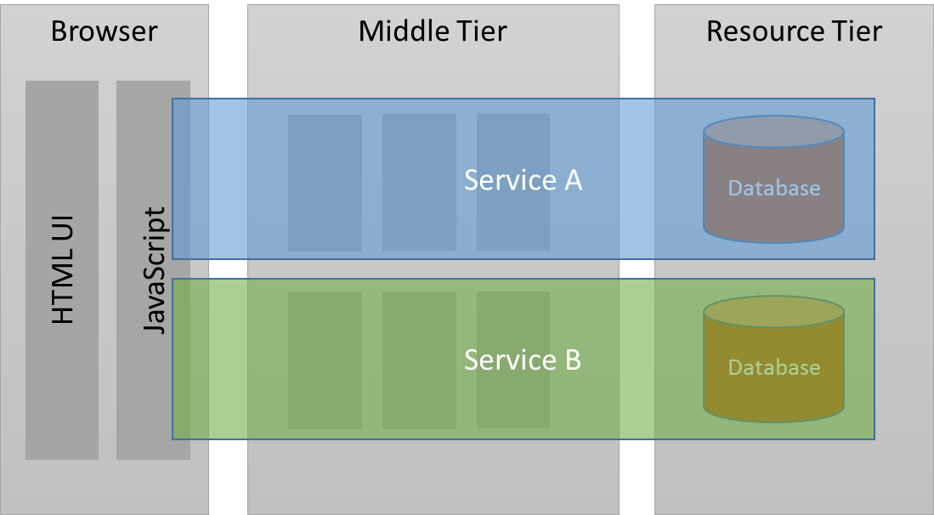
N-Tier / X-Layer ➔ Microservice
➔

Slide 25
Microservice Examples

Slide 26
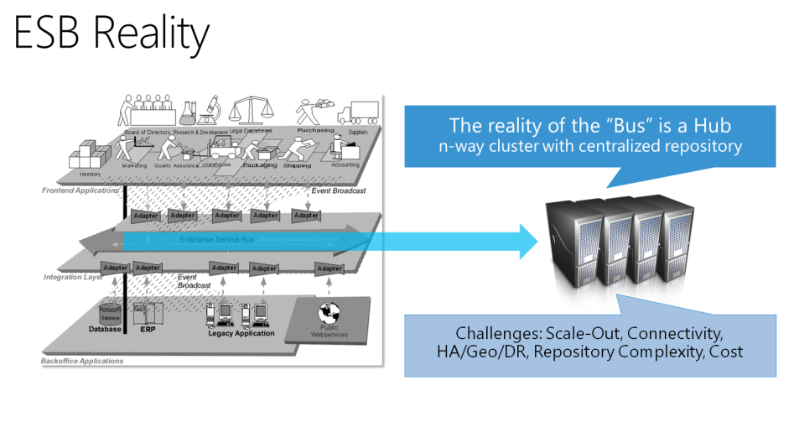
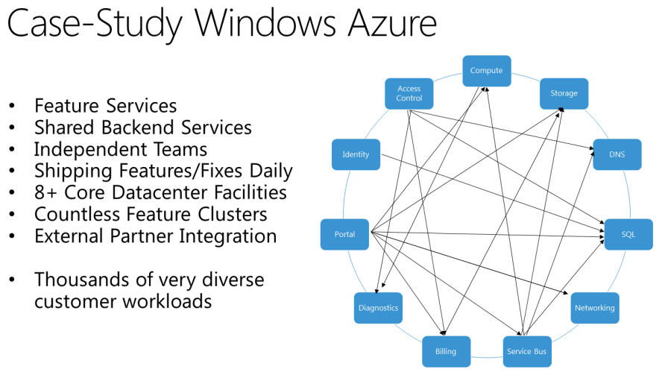
Microservice Example 1: Microsoft Azure
Clemens Vasters: Utopia ESB
http://channel9.msdn.com/Blogs/Subscribe/Wheres-the-ESB

Slide 27

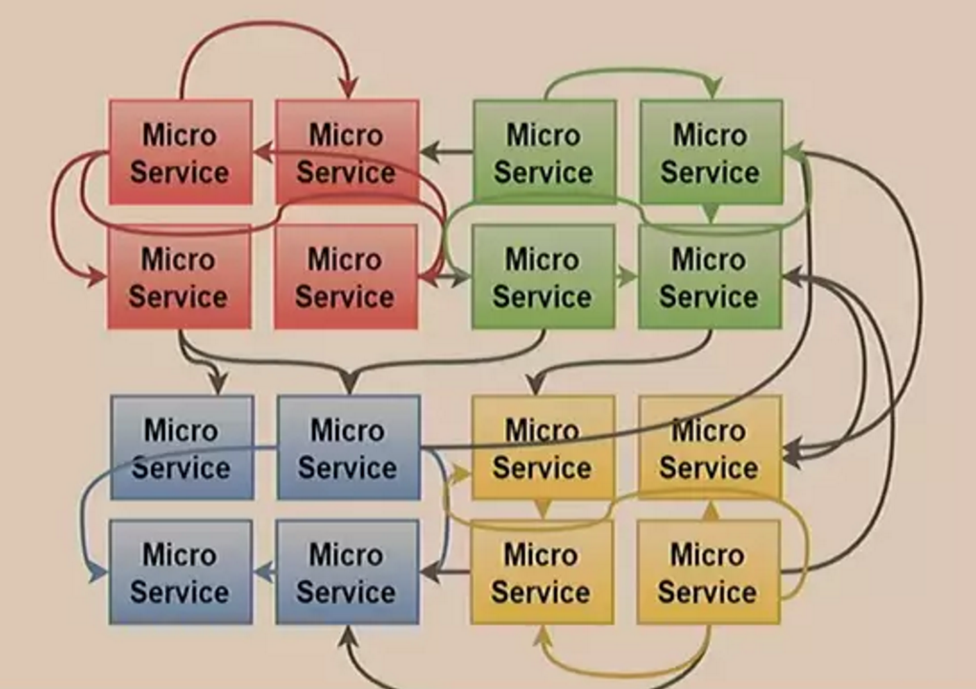
Microservice Example 2
«MicroMonolith - Top anti-patterns of distributed systems» - Michal Franc
NDC Oslo 2016
https://vimeo.com/171704583

Slide 28

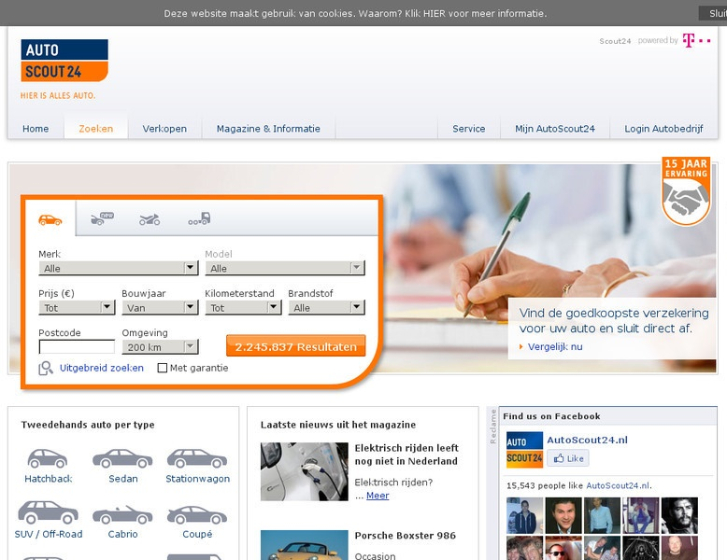
Microservice Example 3
«A High-Performance Solution to Microservices UI Composition»
NDC Oslo 2016
https://vimeo.com/171927597

Slide 29
Inside TicTacTech

Slide 30






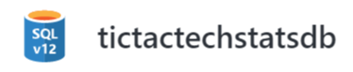

“Branding Service”
Logged-In
HTML - JS
HTML - JS
HTML - JS
SignalR
SignalR
Web API
Web API
Reliable Actors
Reliable Service
Service Bus Listener
Web API
Architeture Overview
Data Collector
Document DB
ServiceBus
PlayerChanged
Game Events

Slide 31


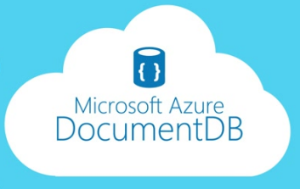



Microservice Example 4: TicTacTech
PlayerService
GameService
StatisticsService
User Interface
Azure Web Job
Service Fabric
Reliable Actors
aurelia.io
Sql Server
Azure ServiceBus

Slide 32
Azure Service Fabric
Cluster Management
Stateful Middle Tier
Runs any EXE
Specific APIs
Reliable Actors
Reliable Services
Rolling Updates

Slide 33
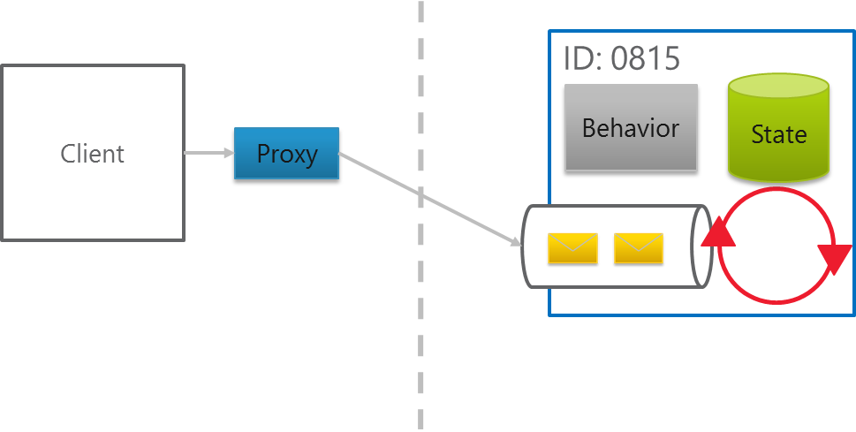
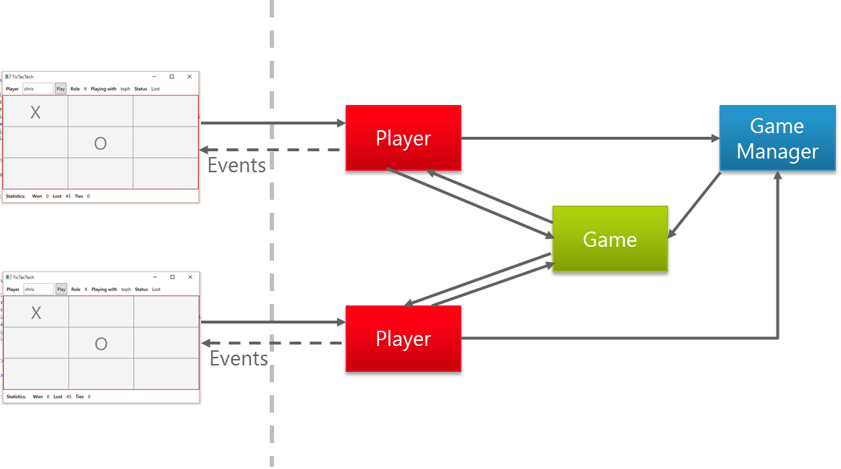
Actors: “Objects done right”

Slide 34





Other Technologies to look at
Actors
Messaging
Server
Server to UI
NServiceBus

Slide 35
Microservice Challenges
UI Composition – How to separate UI parts?
Complexity
Logging / Monitoring
Integration testing
Deployment
Notes:
Rest protocols instead of WS* or BPEL or ESB.

Slide 36
Summary
Da muss noch was hin.
Notes:
Rest protocols instead of WS* or BPEL or ESB.

Slide 37
Thank You!
Manuel Meyer (manuel.meyer@trivadis.com)
Christoph Pletz (christoph.pletz@trivadis.com)

